Slide 1


SARANATHAN COLLEGE OF ENGINEERING
Electronics And Communication Engineering
TITLE:
AN IMPROVED CONDITIONAL PRIVACY PROTECTION SCHEME BASED ON RING SIGNCRYPTION FOR VANET
Team Supervisor:
Dr.S.A. Arunmozhi,phd
Team Members:
Sruti D 232087
Suthika K 232092
Sheela Angel S 232075
Yahitha S 232107

Slide 2
OBJECTIVE
Enhance privacy protection using ring signature encryption, ensuring resilience against attacks, scalability, and user-friendly integration for widespread adoption in digital environments.
ABSTRACT
The VANETs offer safety, data communication, traffic management, and entertainment but are prone to attacks. Many Conditional Privacy Protection (CPP) schemes exist. In 2021, Cai et al. proposed a CPP scheme based on ring signcryption for VANETs, claiming confidentiality, unforgeability, anonymity, and traceability.
We proposed an improved version with security proofs (SET ALGORITHM) in the random oracle model, outperforming the original in security and efficiency, ideal for VANET security and privacy.

Slide 3
LITERATURE SURVEY
TITLE | AUTHOR(S) | YEAR OF PUBLICATION | PUBLICATION
BENBI: SCALABLE AND DYNAMIC ACCESS CONTROL ON THE NORTHBOUND INTERFACE OF SDN-BASED VANET | J. Weng, J. Weng, Y. Zhang, W. Luo, and W. Lan | 2019 | IEEE Transactions on Vehicular Technology
RELIABLE COOPERATIVE AUTHENTICATION FOR VEHICULAR NETWORKS | H. J. Jo, I. S. Kim, and D. H. Lee | 2018 | IEEE Transactions on Intelligent Transportation Systems
BIG DATA DRIVEN VEHICULAR NETWORKS, | N. Cheng, F. Lyu, J. Chen, W. Xu, H. Zhou, S. Zhang | 2018 | IEEE Network

Slide 4
EXISTING SYSTEM
This research proposes a new attack called CPP that compromises the quality of service in VANET communications. The study assesses the practicality of this attack by modeling vehicle movements and analyzing the attacker's chances of success.
It demonstrates that attackers can adapt strategies based on different environments to maximize their success rates.
Simulations conducted using NS2 confirm the feasibility of the CPP attack, with results indicating a high probability of success when employing effective strategies.

Slide 5
PROPOSED METHODOLOGY
We aim to enhance VANET security and scalability through relay selection based on predictive models. Our architecture involves a trusted authority (TA), RSUs, and vehicles. TA manages registration and key distribution, while RSUs provide services and vehicles communicate via OBUs.
Our proposed protocol includes an initialization phase, distance-bounding phase, and verification phase, ensuring entity and proximity authentication. The protocol leverages SET schemes for secure data transmission and RSA encryption for data confidentiality. Security analysis confirms entity and proximity authentication.

Slide 6

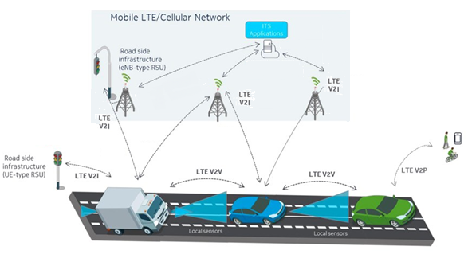
PROPOSED ARCHITECURE

Slide 7
PROPOSED MODULES
Wireless Network Initialization
VANET Deployment
Self-Organization Phase
Scheduling Key Computing Phase
Operational Phase
SET Protocol
Exception Handling Phase

Slide 8
BLOCK DIAGRAM
No. of Nodes
Network Formation
Formation
V2V
V2I
Block Number
Block Key Gen.
Key Verification
Source to Destination Selection
Public Key
Private Key
Route Establishment
Key Broadcast
Nodes Sharing
Data Transmission

Slide 9


GROUP KEY ESTABLISHMENT PROTOCOL
Setup. The BS (as a trust authority) generates a master key mk and public parameters for the private key generator (PKG), and gives them to all sensor nodes.
Extraction. Given an ID string, a sensor node generates a private key send ID associated with the ID using mk.
Signature signing. Given a message M, time stamp t and a signing key , the sending node generates a signature SIG.
Verification. Given the ID, M, and SIG, the receiving node outputs “accept” if SIG is valid, and outputs “reject” otherwise.

Slide 10
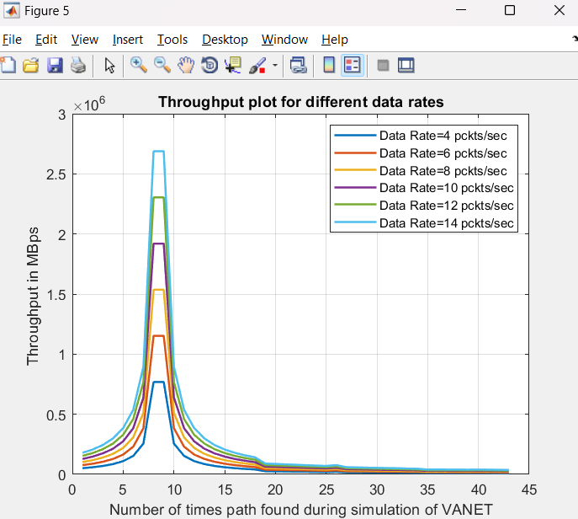
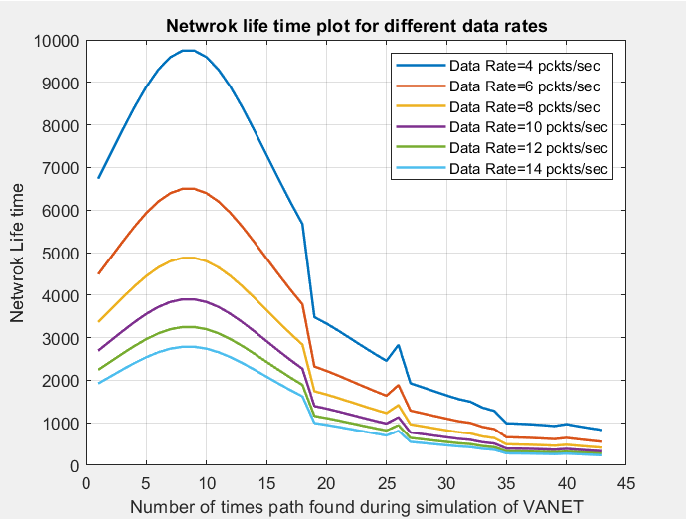
RESULTS
We're testing how secure our proposed protocols are against different kinds of attacks in VANETs. We're also looking at how adding extra security measures affects things like energy use and how long the network stays up.
Our Results :
Fig 1. Throughput plot
Fig 2. Network lifetime

Slide 11
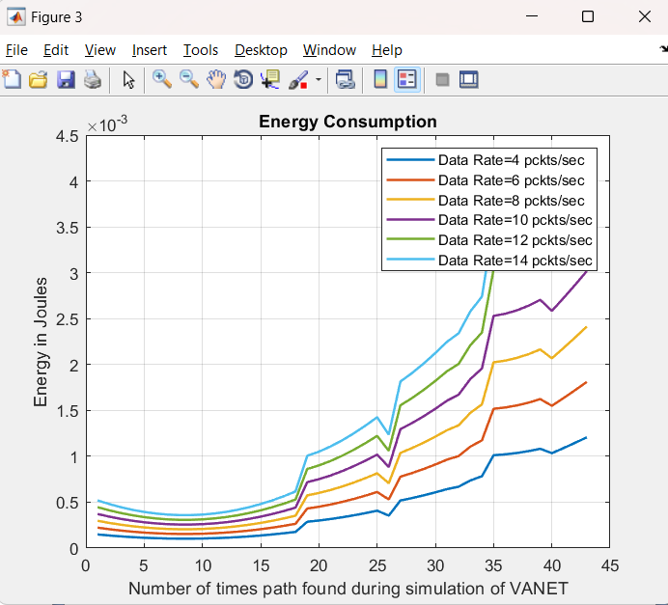
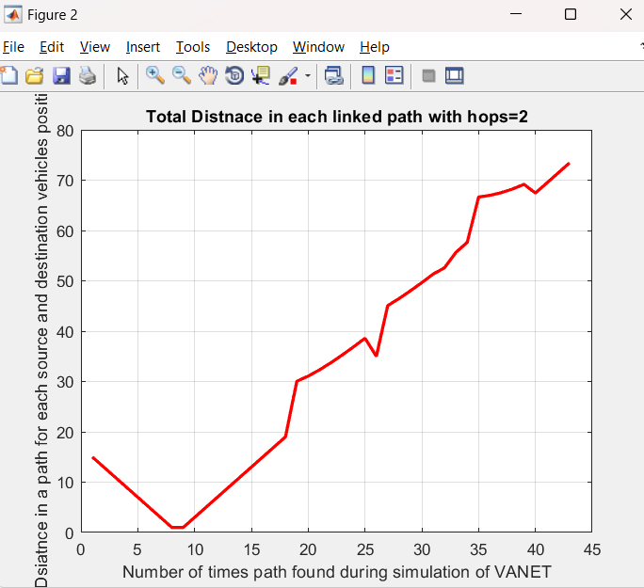
Fig 3. Energy Consumption
Fig 4. Total Distance

Slide 12
CONCLUSION
We present a novel routing and security framework for Secure Efficiency data Transmission (SET) in Vehicular Ad Hoc Networks (VANETs). Our approach prioritizes route stability and introduces an incremental packet allocation scheme to minimize time complexity.
By routing packets through multiple stable paths and leveraging both V2V and V2I communication, our framework enhances transmission performance. Simulation results demonstrate its superiority over existing schemes in delivery metrics and buffer occupancy, highlighting its potential for advancing VANET data transmission efficiency.

Slide 13
REFERENCES
J. Weng, J. Weng, Y. Zhang, W. Luo, and W. Lan, “Benbi: Scalable and dynamic access control on the northbound interface of sdn-based vanet,” IEEE Transactions on Vehicular Technology, vol. 68, no. 1, pp. 822–831, (2019).
H. J. Jo, I. S. Kim, and D. H. Lee, “Reliable cooperative authentication for vehicular networks,” IEEE Transactions on Intelligent Transportation Systems, vol. 19, no. 4, pp. 1065–1079,( 2018).
N. Cheng, F. Lyu, J. Chen, W. Xu, H. Zhou, S. Zhang, and X. Shen, “Big data driven vehicular networks,” IEEE Network, vol. 32, no. 6, pp. 160–167, (2018).

Slide 14


